Slide 1
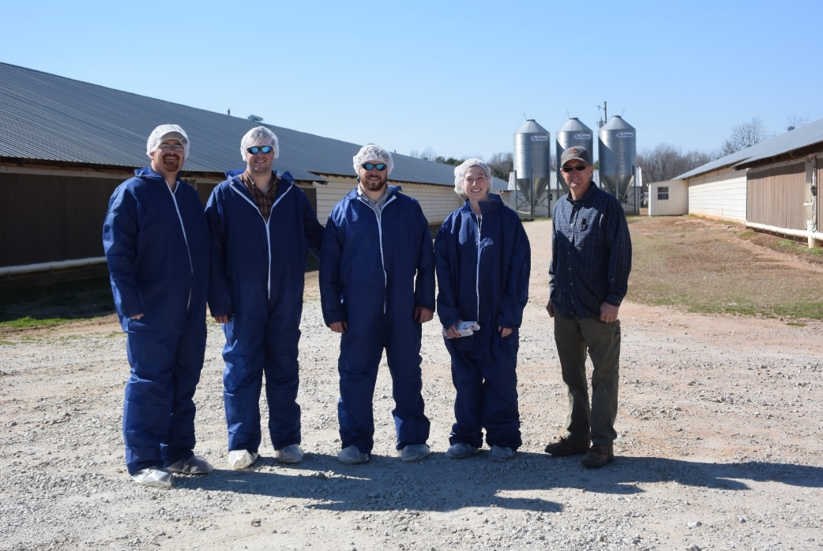
Oral Proposal Presentation
Team: Don’t Let the Chickens Go Hungry
Automated Feed Bin Gate System
Group Members:
Brock Daughtry, Trey Colley, Holly Haber
February 19th, 2016

Slide 2
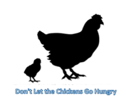
Presentation Outline
Background
Methodology and Procedures
  Problem statement
  Design objectives
  Why is this needed, related tech?
  Alternative Solutions
  Design requirements/constraints
  Visuals
  Preliminary analysis
  Recommendation

Slide 3

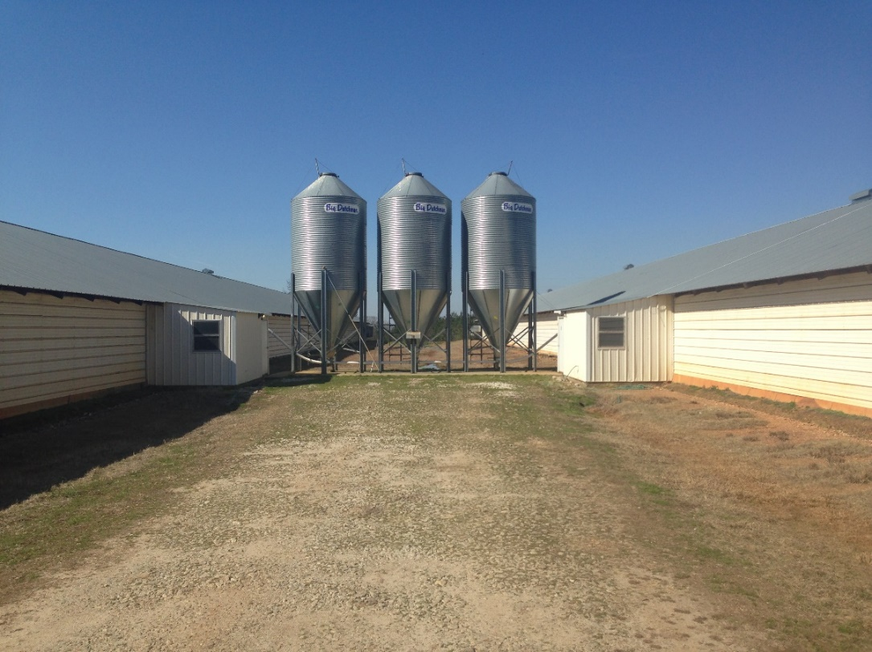
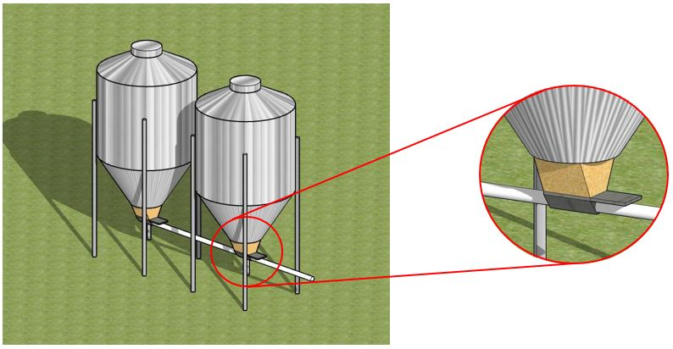
Background
Feed Boot
Auger Housing
Slide Gate
One house - Tandem Feed Bin System
King Trail Farm – Newsite, AL
Images taken or created by: Trey Colley
Notes:
Describe problem statement:
Sophisticated climate control systems allow for a minimal farmer input
Feed is conveyed from multiple feed bins into the poultry houses through a flexible auger system
Currently, the farmer has to manually open and close the slide gate on the bottom of the bins in order
The farmer could be sleeping or out of town, leading to a lapse in feed from the birds and a loss of profits
Our design will streamline the process by providing a continual supply of food to the broilers

Slide 4
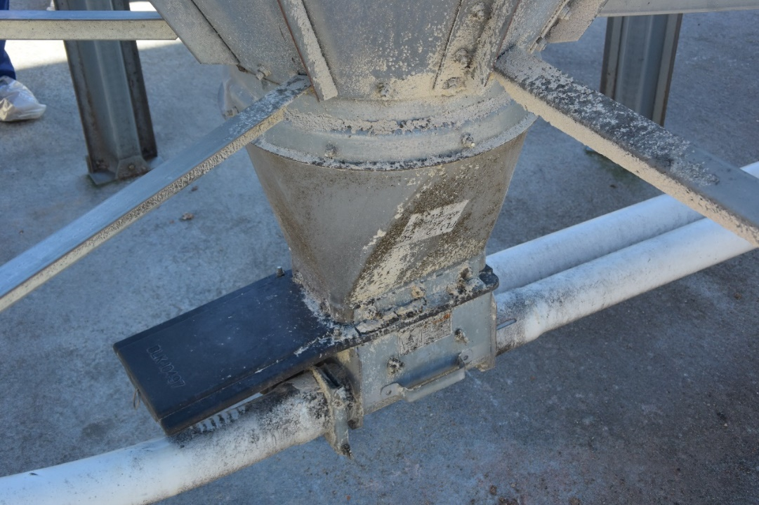
Design Objective 1
Functioning opening/closing mechanism that is:
  Cost-effective.
    < $1,000
  Durable – see picture.
  Compatible.
  Safe – constrained by:
  ASABE Shielding Standards
    S318.17 JUN2009
    S493.1 JUL2003 (R2012)
Image taken by: Trey Colley
Notes:
Cost effective – under $1000, flowhammer costs $850
Durability – has to deal with humidity, heat,
- Wires wrapped in conduit
Compatibility –easily integrated into current systems or the farmers will not invest
Safety – moving parts → shielding
Electrical Safety

Slide 5
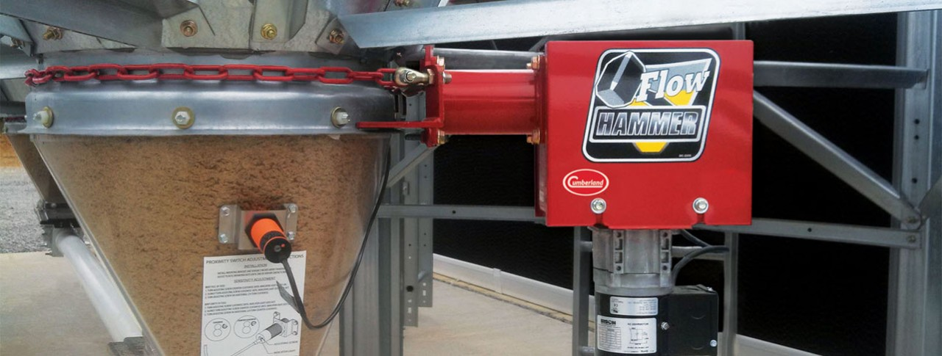
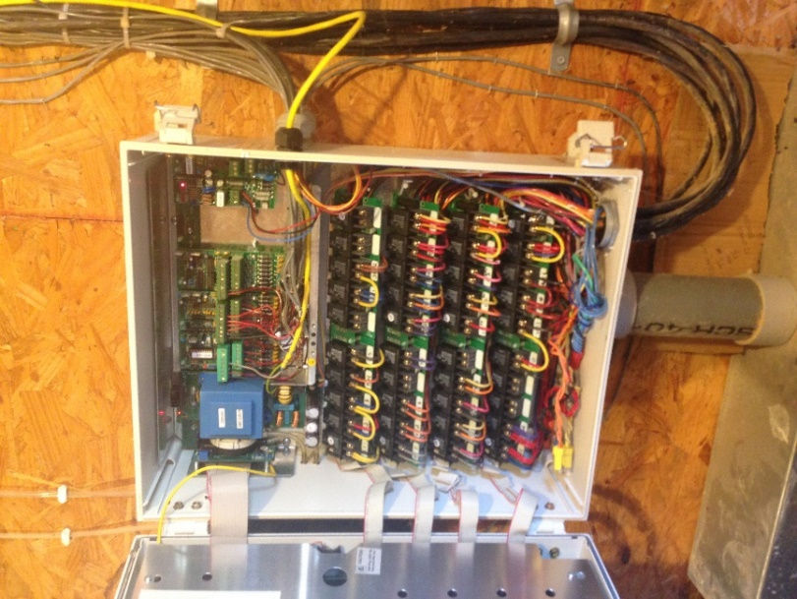
Design Objective 2
Create a sensor system compatible with current climate control system:
  Proximity Sensor
    Already in use by Cumberland in the Flow Hammer® Device.
  Logic statements:
    Three bin, Two house systems
    Two bin, One house systems
Image taken by: Trey Colley
Image credit: http://www.cumberlandpoultry.com/products/storage-and-delivery/flow-hammer.html
Notes:
Proximity sensor – emits an electromagnetic field, looks for changes in the field or return signal
Lack of moving parts, also not affected by dust particles unlike a laser

Slide 6
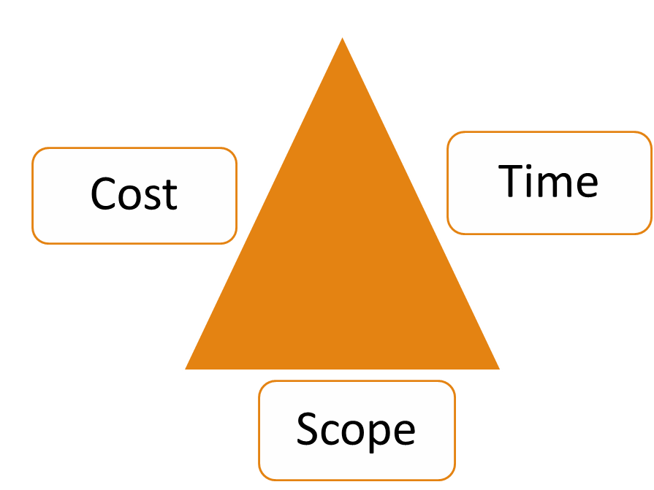

Constraints
Justification
→ How would an automatic feed gate affect farm efficiency?
Discontinuous supply of feed = Loss of profit!
Less time spent checking feed bin levels, more time working ($).
Cost
  Sheet metal
Safety
  ASABE guarding standards
User-friendliness
  Retro – fit old bins
Compatibility
  “Sensor” side
  Sizing
Notes:
***Ask the question to audience first before reading the slide!***
By avoiding lapse in feeding rate, the farmer will maximize weight gain for all broilers.
Less for farmer to be concerned with
Cost – sheet metal easy and cheap to manipulate!
Safety – moving parts are now incased by design, unlike previous design
User friendliness – ease of retro fit
- disconnect if power goes out
Sensors – mass produced and easily integrated
- Sizing - height constrained by feed truck auger

Slide 7
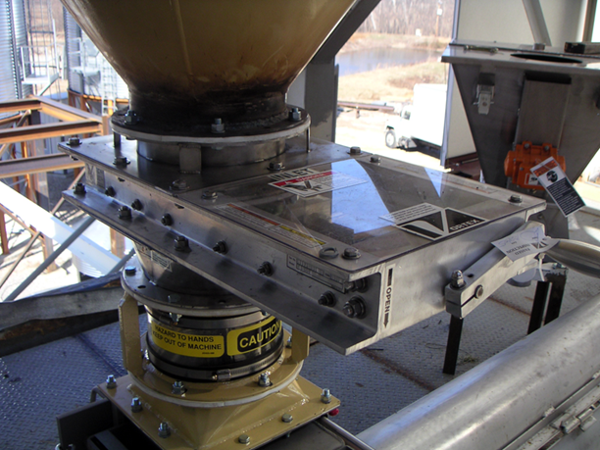

Prior Arts
  Proximity Sensor
    Already in use by Cumberland in the Flow Hammer® Device.
Vortex Model Salina - Roller Gate Valve
  Linear Actuated
$11,841.12 – High Performance
Image credit: http://www.vortexvalves.com/maintenance-gate/#tab-id-1
Notes:
Proximity Sensor – explain the flowhammer
- Already manufactured by Cumberland.
- Easily integrated to boot, do not have to cut into the boot.
Vortex Roller Gate – used in a flour mill
- Extensive sealing, high precision.
- Expensive.
- In-line linear actuator, all moving parts encased.
- We want lower tech version of this valve.

Slide 8
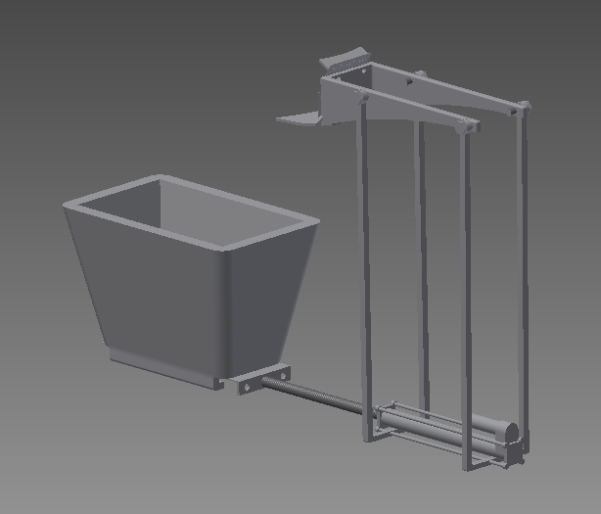
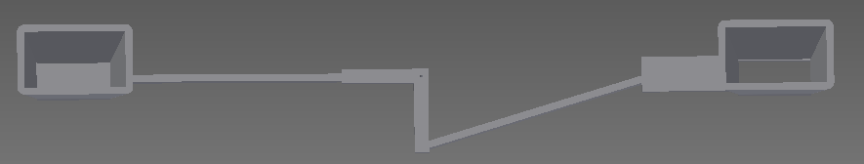
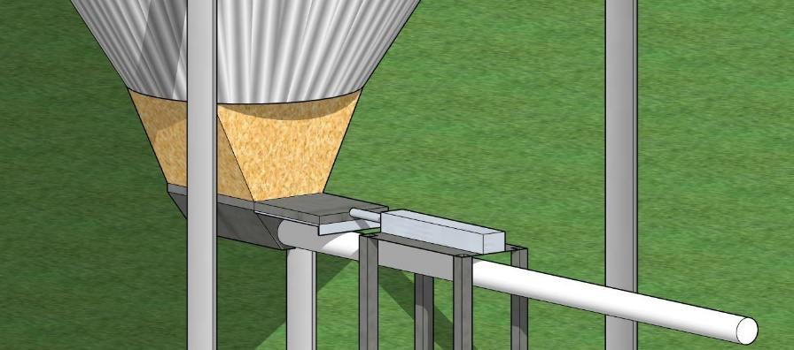
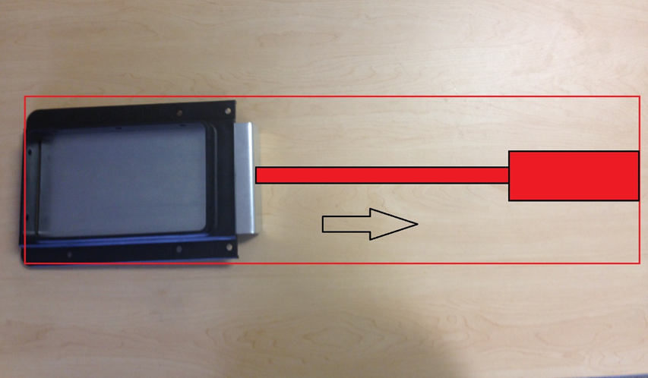
Project Development
Tandem bin, mechanical system
Single bin stand-alone, sensor controlled system
Single bin mounted, sensor controlled system
Internally mounted, sensor controlled system
AutoCAD Inventor Images: Brock Daughtry
SketchUp Images: Trey Colley
Notes:
Tandem bin – too many moving parts, alignment and spacing problems
Single bin stand alone – variable hopper heights, bracing concerns
Single bin mounted – bracing concerns, moment arm, very specific alignment in order to function
Internal mounted system
- allows for easy alignment,
-fewer stress forces (more linear stress than vertical)
- all moving parts are internal (safety)

Slide 9
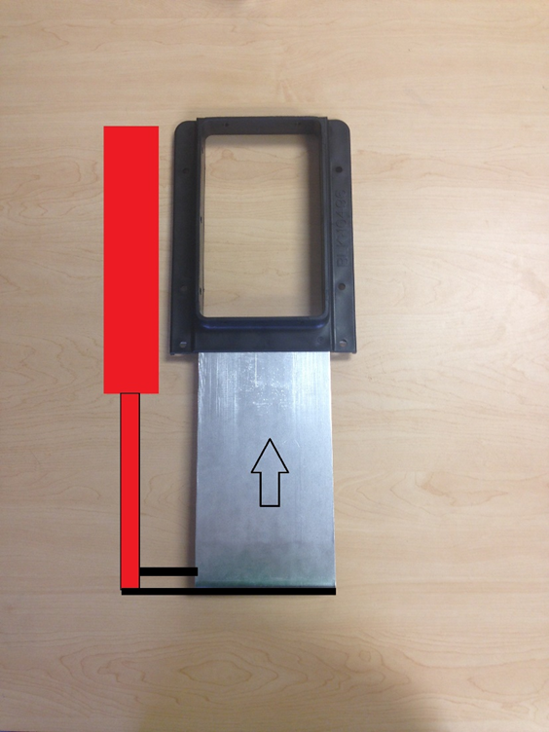

Alternative #1:
“Side Mounted Linear Actuator System”
Adapt the transition piece to mount linear actuator in reverse
Pros:
  Compact shape allowing for ample spacing under bin
  Minimal cost:
    $459.68
Cons:
  Awkward mounting to gate
Linear Actuator
“Side Mounted Alternative” (#1)
*Arrow indicates direction of movement
Image created by: Trey Colley
Notes:
1.) Side Mounted
- Must adapt transition piece
- Will have to replace on all retrofitted bins
- Only need to adjust plastic mold
- No spacing adjustment needed for auger concerns
- Alignment issues with plate (pulling sideways)

Slide 10

Alternative #2:
“In-line Linear Actuator System”
Design transition unit to hold linear actuator
Pros:
  Allows for all linear in-line forces
  Safety!
  Minimal cost:
    $467.36
Cons:
  Height concerns -
  Maintenance concerns
Linear Actuator
Slide Gate
“In-line Alternative” (#2)
*Arrow indicates direction of movement
Image created by: Trey Colley
Notes:
2.) In-line
- Individual unit ( bolt on and go )
- Linear in-line forces
- Do not have to redesign transition piece
- SAFETY – all moving parts are contained within the system
- Height concerns, maintenance concerns

Slide 11
Project Timeline
- Complete AutoCAD drawings of both alternatives and present to client.
- ePortfolio Completion.
- Finalized logic statements tailored to requirements of climate control system.
March 1st
- Safety housing is designed with ASABE shielding standards.
- Stress analysis through AutoCAD
- Linear actuator selection specified to > 145lb capacity.
March 11th
- Build/Test Prototypes
- Programmed logic codes that collaborate with sensor.
- Final Cost-Analysis.
March 25th

Slide 12
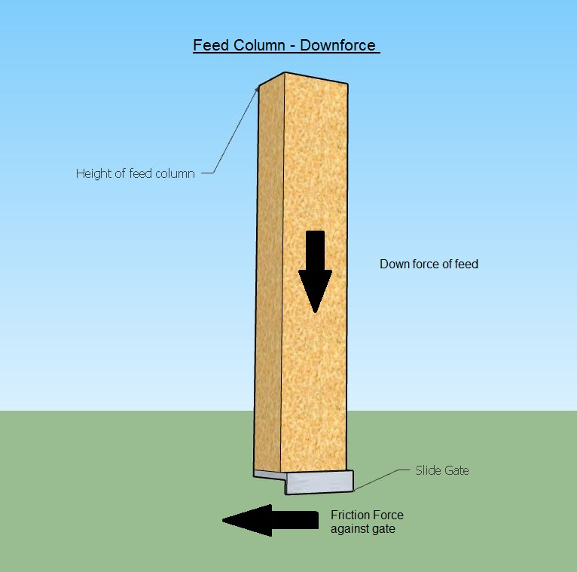
Preliminary Analysis
Logic
  Example:
    Two bins one house
    Three bins, two houses
Force Analysis
  Force needed to open gate at worst case scenario:
    145 lbs.
Analyses to be conducted at later date:
  Stress Analysis – March 11th
  Final Cost Analysis – March 25th
145 lbs.
Image created by: Trey Colley
Notes:
Logic:
2 Bins, 1 house
-If bin A is empty, close gate A and open gate B
3 bins, 2 houses
-If bin A is full, open gate A and ensure gate B and C are closed
-Starter feed, grower feed, finishing feed 1, finishing feed 2
Force Analysis
- Get help from Dr. Fasina to calculate total force on gate
Stress Analysis
- Conducted in AutoCAD
Cost Analysis
- Use ASABE quarterscale price sheet

Slide 13
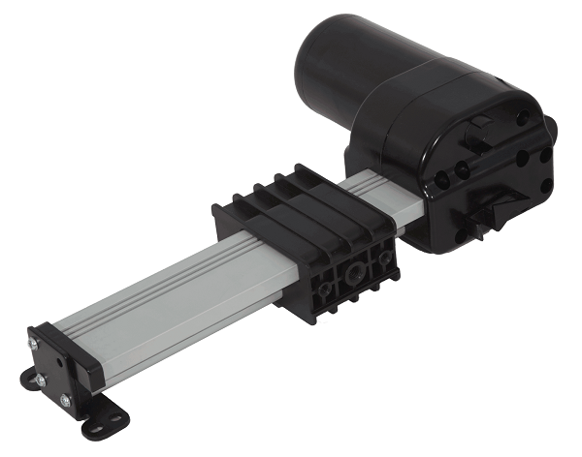
Linear Actuator Selection
What are we looking for?
  Force Requirement?
  Price
  Durability
  Example:
  Track Linear Actuator Model: PA-18
  900 lb capacity
  $185
  Medium Duty – 10” Stroke
Image Credit: http://www.progressiveautomations.com/media/catalog/product/cache/2/image/415x415/9df78eab33525d08d6e5fb8d27136e95/t/r/track-actuator_1.png
Notes:
10” stroke neede
Tracked actuator will reduce
Force capacity not a concern
Will be shielded for maximum service life
Want to be as compact as possible while maintaining 10” stroke

Slide 14
Design Recommendation
Alternative #2: “In-line” Linear Actuated System
  Why?
    Reduction of stress forces on slide gate
    Easily aligned by operator
    Retrofit
  Preliminary Cost estimate
    $467.36
Notes:
Why?
-Reduction of stress forces on slide gate (all forces linear and straight away from system
- Retrofit – can be inserted into existing systems under current trasition piece
- Easily alignment – individual with little background knowledge can operate

Slide 15
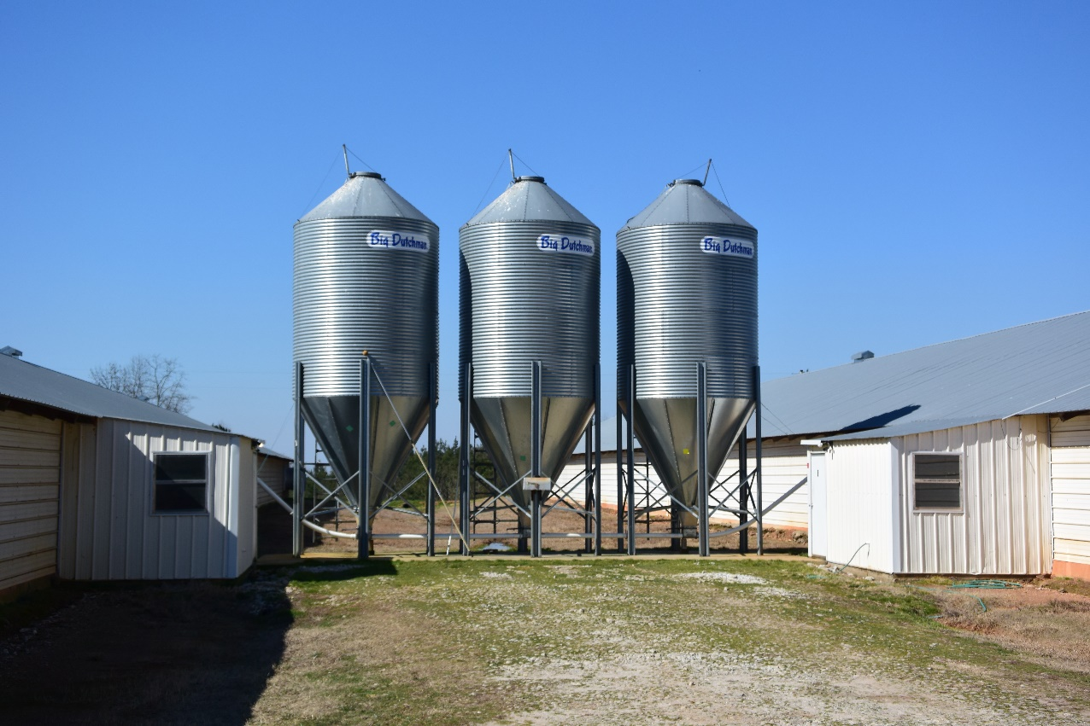
Summary
What to expect from the final product:
  Precise AutoCAD Drawings
    Stress Analysis Testing
  Safety Considerations
  Final Cost Analysis – Return Period
  Hopefully, functional prototypes!
Image created by: Trey Colley

Slide 16
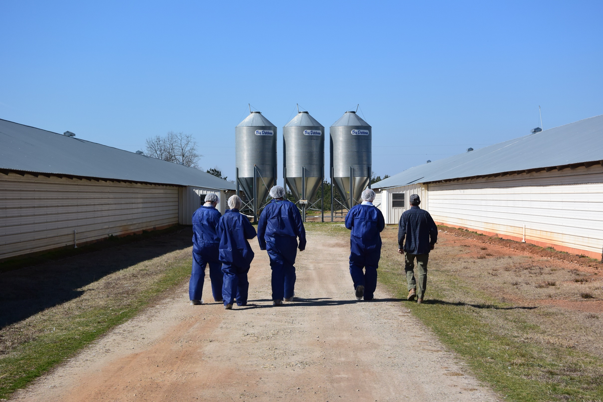
Questions/Comments?
Image Credit: Dr. Jeremiah Davis

